Slide 1
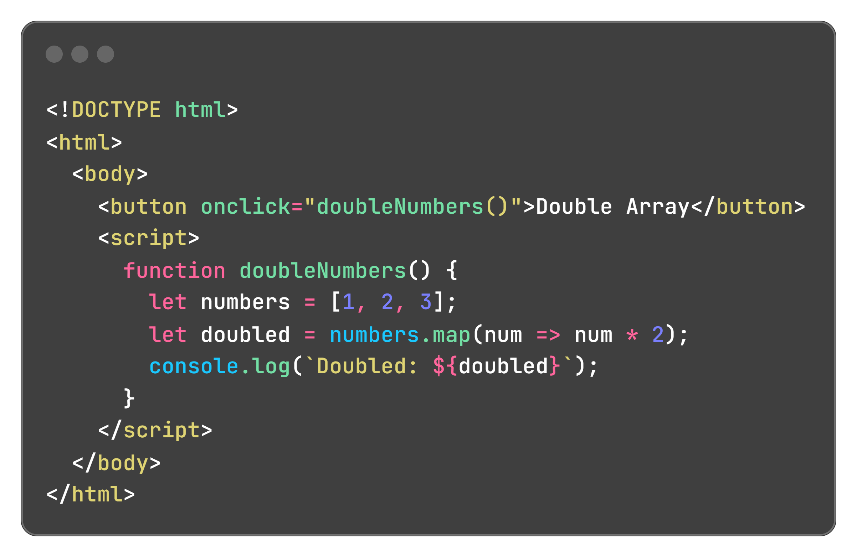
Can we combine arrays and functions??

Slide 2

Objects

Slide 3
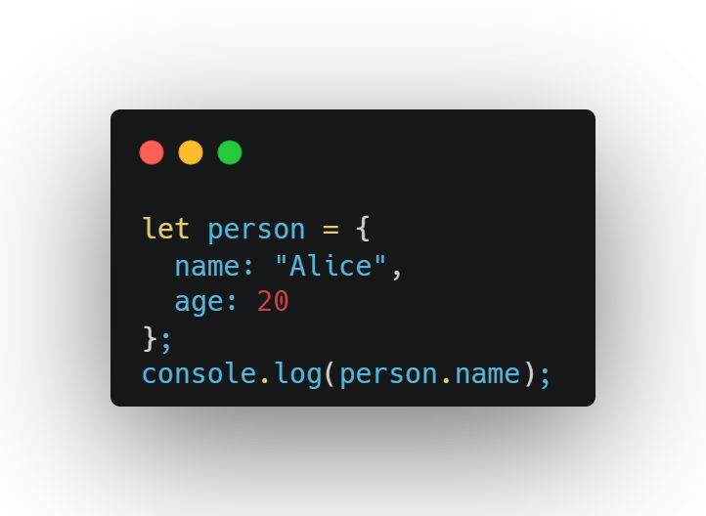
What’s an Object?
A way to store related data, like a labeled box for a person’s name, age, and city.
Uses key-value pairs (e.g., name: "Alice").

Slide 4
Why Use Objects?
Group related data (e.g., a car’s make and model).
Make code organized and reusable.
Work with functions to do tasks like updating profiles.
How to Create and Use Objects:
Object Literal: Define with {}:

Slide 5
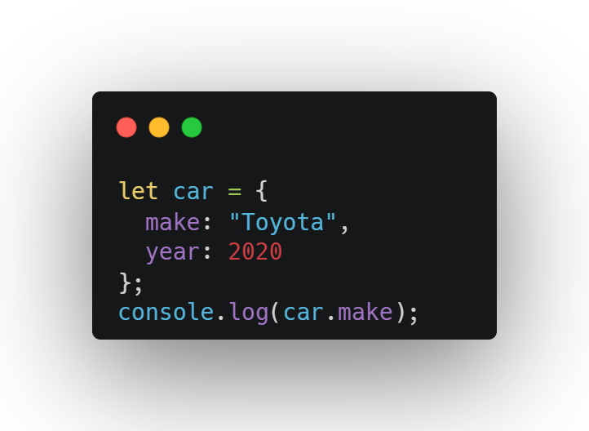
Accessing Properties
Dot notation: car.make
Bracket notation: car["make"] (useful for dynamic keys)

Slide 6
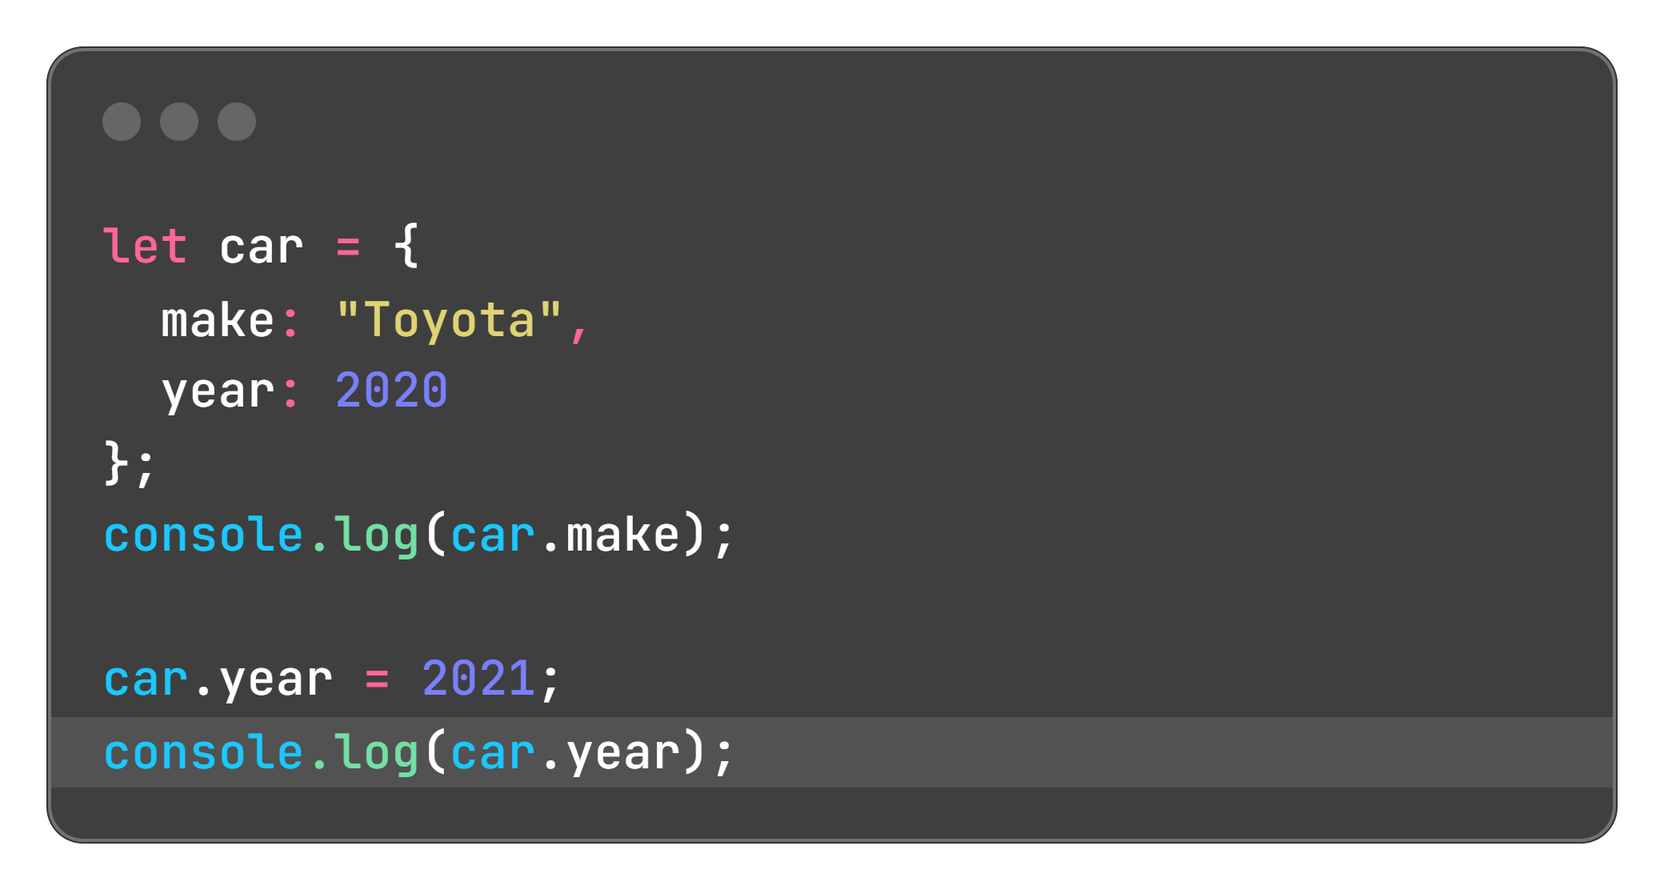
Updating Properties:

Slide 7
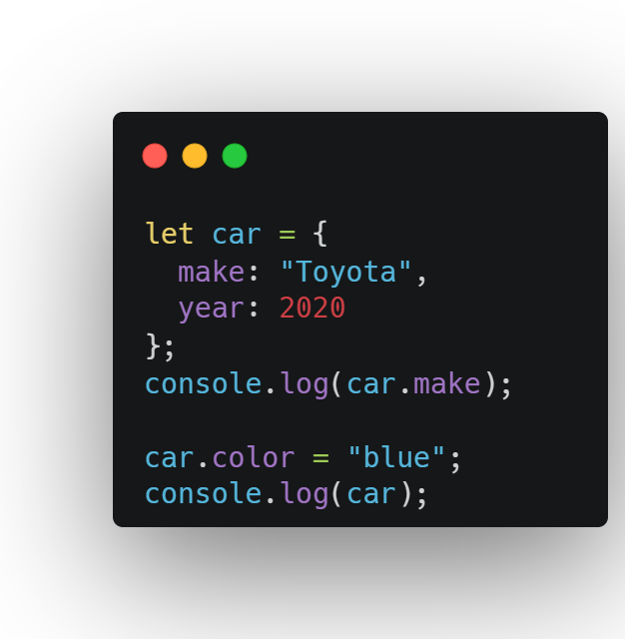
Adding Properties:
Dot notation: car.make
Bracket notation: car["make"]

Slide 8
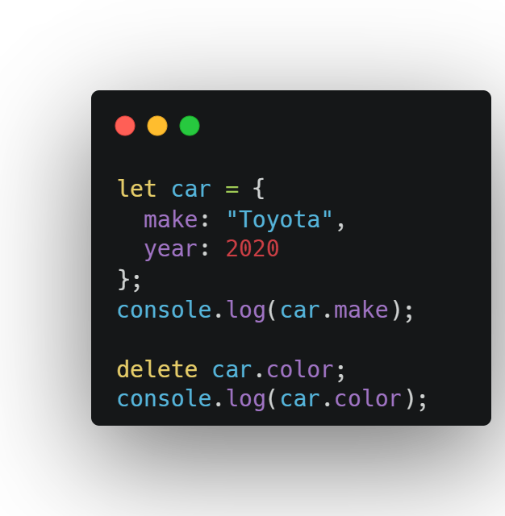
Deleting Properties:

Slide 9

Tips
Use clear key names (e.g., name, age).
Dot notation is simpler; use bracket notation for keys with spaces or variables.
Objects can hold strings, numbers, arrays, functions, or other objects.

Slide 10
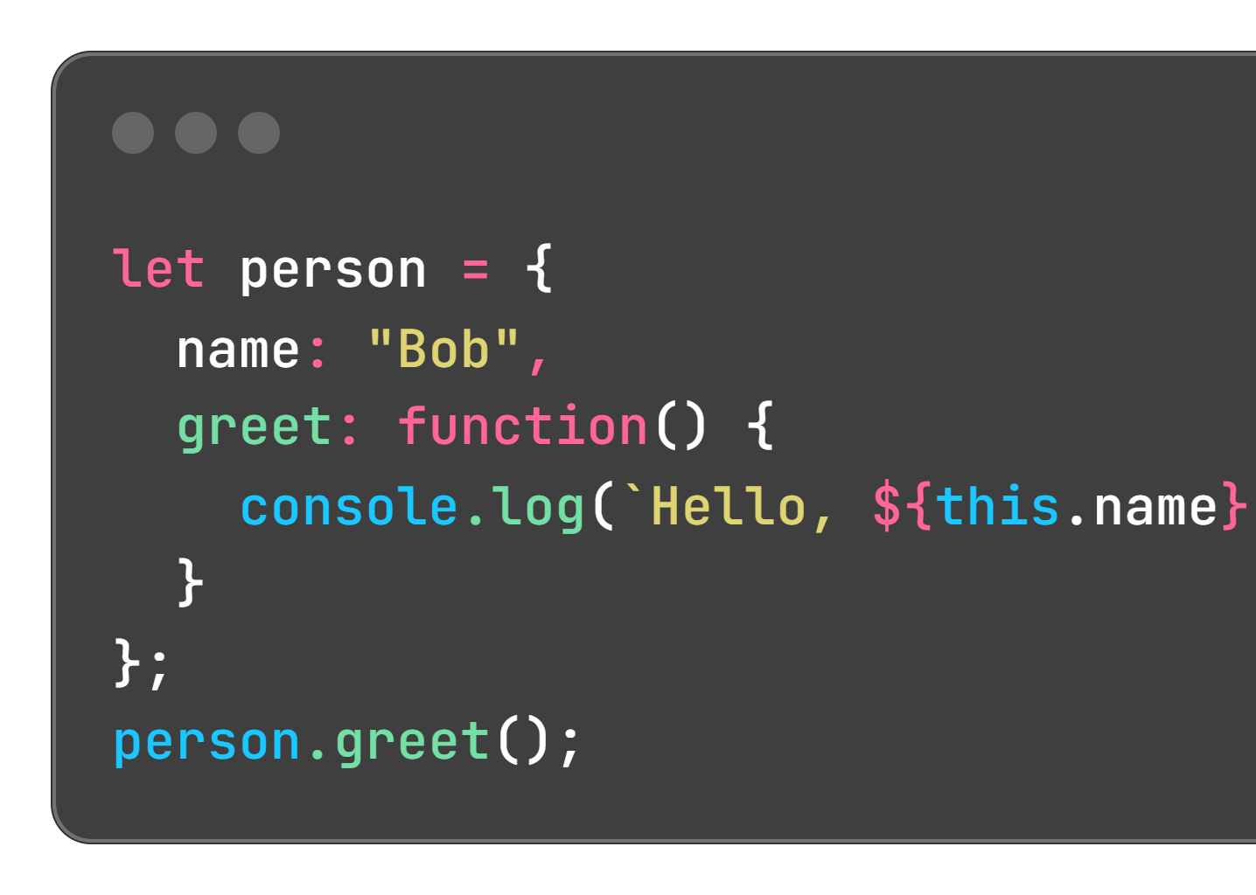
Object Methods and Loops
Methods:
Functions stored in objects to perform actions.
Use this to access the object’s properties.

Slide 11
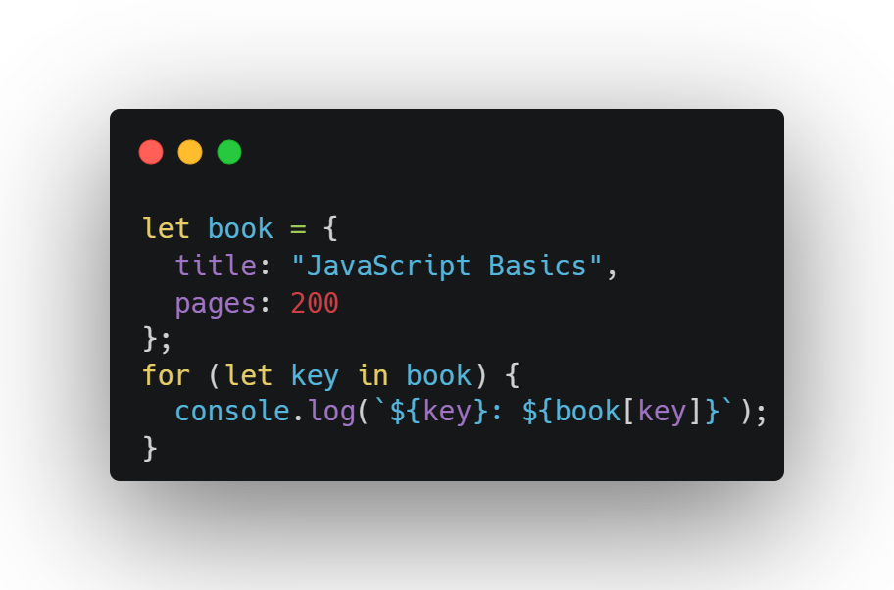
Object Methods and Loops
Looping Over Objects:
Use for...in to iterate through properties:

Slide 12
Object Keys and Values:
Get all keys: Object.keys(book) → ["title", "pages"]
Get all values: Object.values(book) → ["JavaScript Basics", 200]

Slide 13

WHY this matter?
Methods make objects interactive (e.g., a button that greets).
Loops and key/value methods help process object data (e.g., list student grades).

Slide 14
Tips
Use this carefully to avoid referencing the wrong object.
Avoid for loops (meant for arrays); use for...in for objects.

Slide 15
Objects with Conditionals
Why Use Conditionals with Objects?
Make decisions based on properties (e.g., check if a student passed).

Slide 16
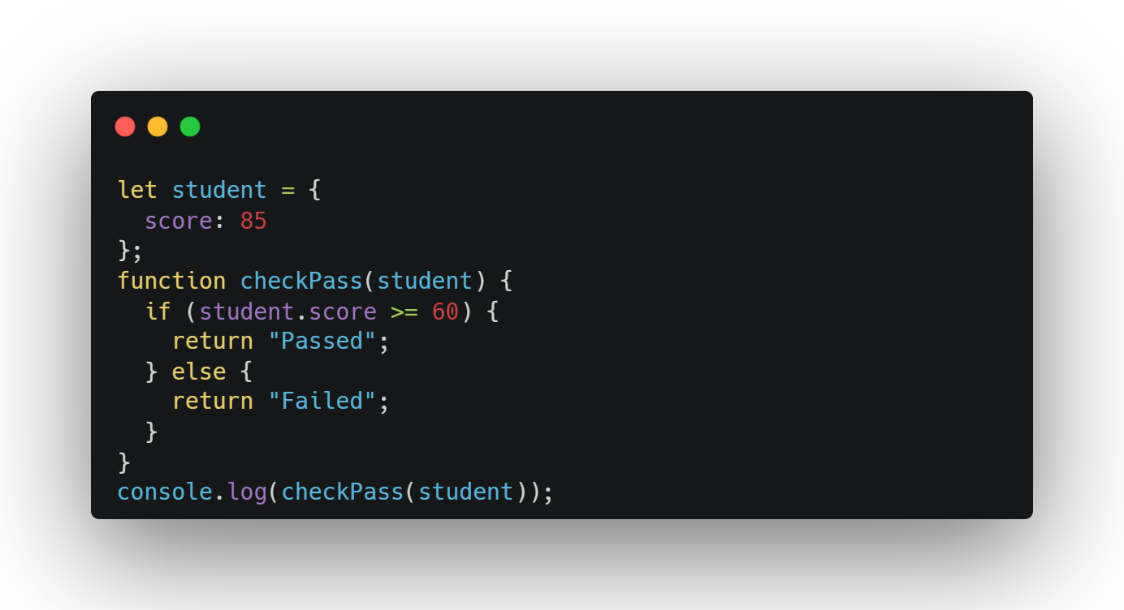
Objects with Conditionals

Slide 17
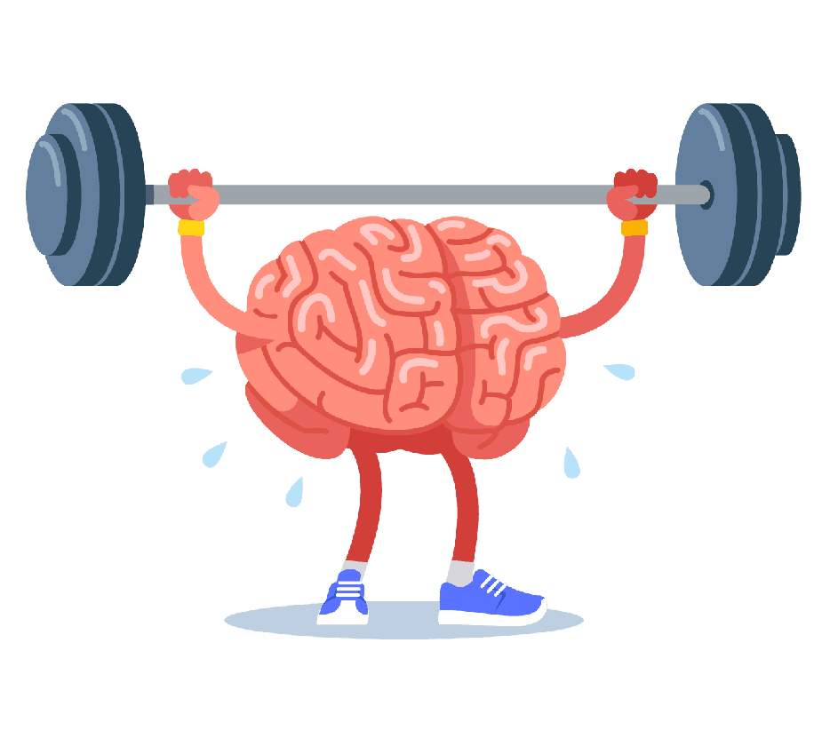
Exercise 1: Create and Access Object
Goal: Make a person object and access properties.
Steps:
Create a person object with name ("Jaadugar") and age (26).
Log the name and age using dot and bracket notation.
Output: Jaadugar, 26

Slide 18
Exercise 2: Update and Add Properties
Goal: Modify and add to an object.
Steps:
Create a car object with model ("Honda") and year (2018).
Update year to 2022 and add color ("red").
Log the updated object.
Output: {model: "Honda", year: 2022, color: "red"}

Slide 19
Exercise 3: Object Method
Goal: Add a method to an object.
Steps:
Create a dog object with name ("Doggy") and a bark method that logs "Woof! I'm Doggy!".
Call the bark method.
Output: Woof! I'm Doggy!

Slide 20
Exercise 4: Loop Over Object
Goal: List all properties using a loop.
Steps:
Create a book object with title ("JavaScript") and pages (300).
Use a for...in loop to log each property and value.
Output: title: JavaScript, pages: 300

Slide 21
Exercise 5: Conditional Object Check
Goal: Check a property with a conditional.
Steps:
Create a student object with grade (75).
Write a function isPassing that returns "Pass" if grade >= 60, else "Fail".
Log the result.
Output: Pass

Slide 22
Exercise 6: Nested Objects
Goal: Work with objects inside objects.
Steps:
Create a person object with name ("Emma") and an address object containing city ("New York") and zip (10001).
Log the city.
Output: New York

Slide 23
Bonus Challenge:
Goal: Build a function to calculate and display student grades.
Steps:
Create two student objects with name, math, science, and english (e.g., "Alice", 85, 90, 78 and "Bob", 70, 80, 90).
Write a function calcAverage that takes a student, calculates the average of their grades, and logs it with two decimal places.
Add a method getStatus to each student that returns "Pass" if the average is >= 60, else "Fail".
Log the name, average, and status for both students.

Slide 24

Why use objects instead of arrays?

Slide 25
Why use objects instead of arrays?
Arrays are best for ordered lists where items have a numeric position (index) - Objects are better when you want to store data with named properties - Use objects when you need to group related data with clear labels, like information about a person, product, or any entity with multiple characteristics.

Slide 26
What does this do in a method?

Slide 27
What does this do in a method?
this refers to the object that "owns" the current code:
Inside a method (a function that's a property of an object), this refers to the object itself. It lets you access other properties of that object.

Slide 28
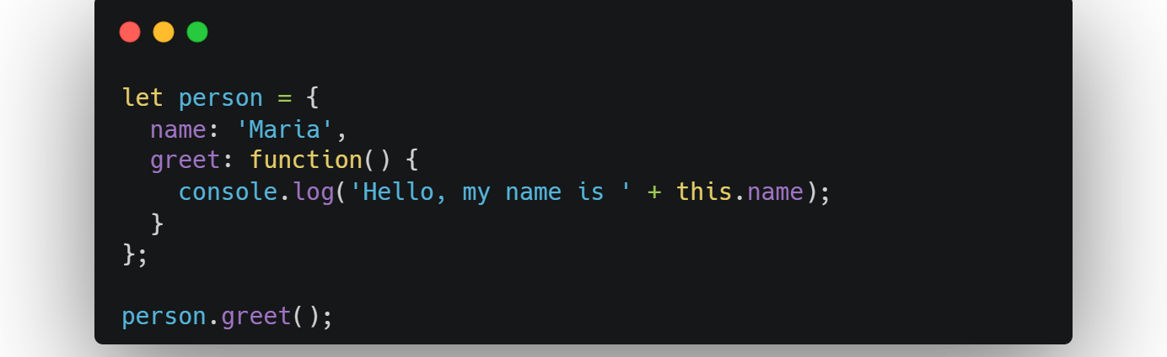
What does this do in a method?
this refers to the object that "owns" the current code:
Inside a method (a function that's a property of an object), this refers to the object itself. It lets you access other properties of that object.

Slide 29
How do you loop over an object?

Slide 30
How do you loop over an object?
There are several ways to loop through an object's properties:

Slide 31
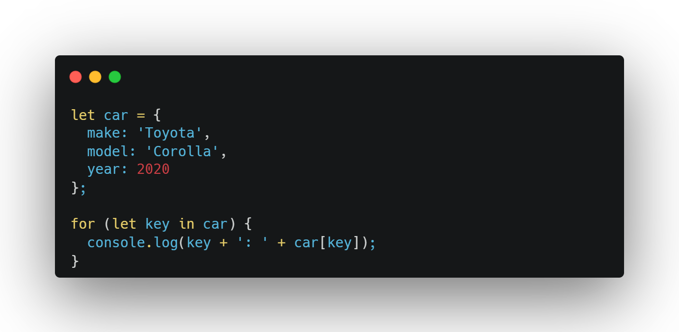
How do you loop over an object?
for...in loop (most common):

Slide 32
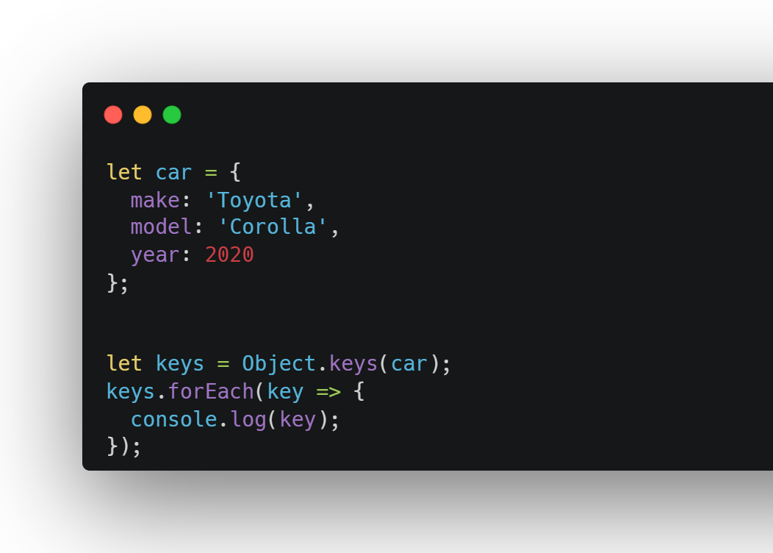
How do you loop over an object?
Object.keys() (gets just the property names)

Slide 33
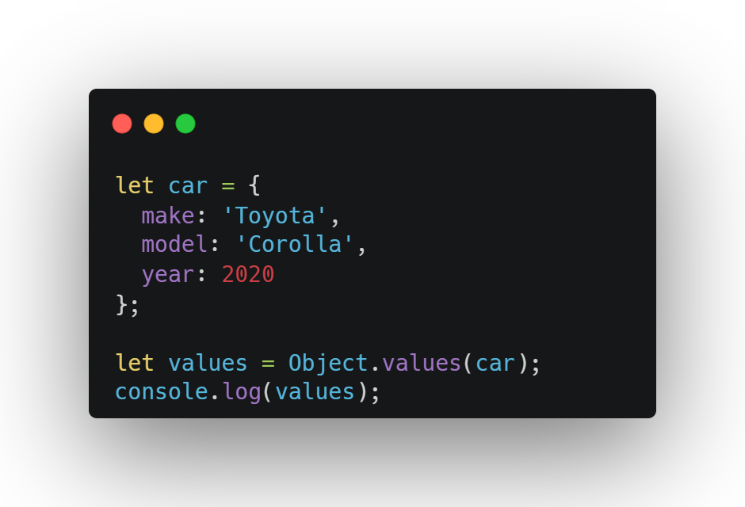
How do you loop over an object?
Object.values() (gets just the values).

Slide 34


Slide 35

Recap...
Objects: Group related data as key-value pairs (e.g., name: "Alice").
Properties: Access with object.key or object["key"].
Methods: Functions in objects using this (e.g., greet()).
Loops: Use for...in or Object.keys/values to process properties.
Conditionals: Check properties (e.g., grade >= 60).
Nested Objects: Store objects inside objects (e.g., address.city).

Slide 36

Thank-You !!!

